Slide 1

EDA ON : VIDEO-STATS DATA of. CYBER_SECURITY COURSE
PARTH UMESHKUMAR SHAH
STUDENT ID: 210468180

Slide 2
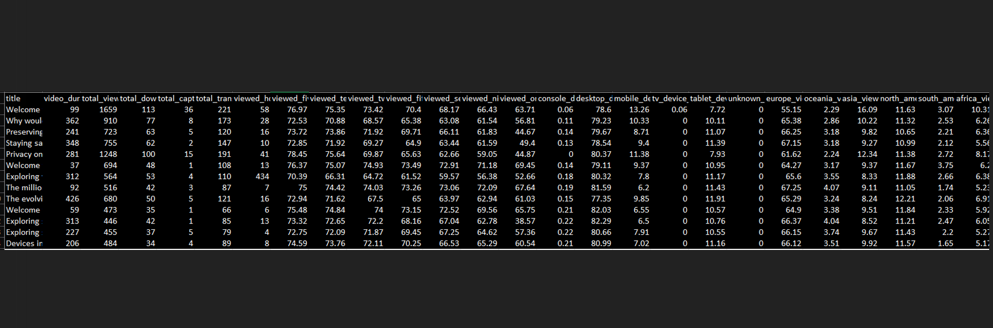
Sample Data
The observations made on these data are developed based on different simulations on a particular period of time.
This report consists of an analysis that is made on the statistics of viewing of the videos.
The data consists of various responses of different course modules like video duration, total views of the course views based on the hardware devices views based on the regions and much more. With these responses an exploratory data analysis is prepared here to get a better insight of the statistics of viewing of the videos using different numerical and graphical analogies.

Slide 3
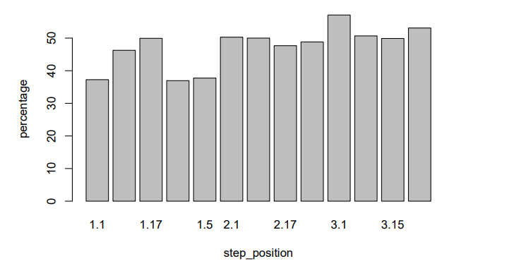
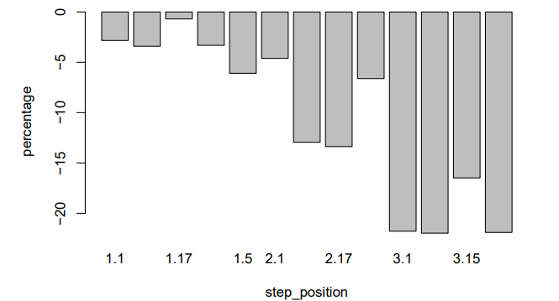
01-Finding the average drop in viewership.
• Top plot represents of total views based on courses for 2 different months with a gap of a year was inserted for visualization purpose.
• Created a data frame named drop-percentage and initialized a for-loop for calculation of drop percentage such that the data of it is stored in a 2-column data frame consisting of drop percentage for each step-position.
• Through the use of drop percentage, average drop is calculated for the explored data file and was viewed that the viewership is dropped 47.35927% in september,2018 in comparison to september,2017
• Lower plot represents of total views based on courses for 2 different months with a gap of a 5 months(approx = half year period) was inserted for visualization purpose. • Created a data frame initialized a for-loop for calculation of drop-percentage for files half year apart such that the data of it is stored in a 2-column data frame consisting of drop percentage for each step-position.
• Through the use of drop percentage, average drop is calculated for the explored data file and was viewed that the viewership was rosed 10.46227 in February,2018 in comparison to september,2017
• From this two exploration it can be assumed that in comparison to Sept,2017 the viewership increased in feb,2018 which shows the increasing interest of people in Cyber Security field and the drop in sept,2018 in comparison to sept,2017 shows that maybe people who want to perceive further in Cyber Security has already enrolled and completed the course or also it can be assumed that the content available has been moved to a saturated zone where people who has interest in this filed are already known to this much of information.

Slide 4
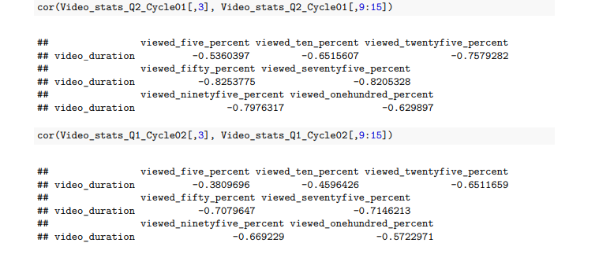
02 Have more people left at less percentage because of the length of the VIDEO?
This negative Co-relation stats that as the video duration increases the video-viewed percentage is dropped and it proves that yes the video duration is a major consideration across all files
Hence it can be assumed that if we make more creative short individual topic videos,it might help people to continue with the course as many people who have started have never reached the end of particular video.

Slide 5
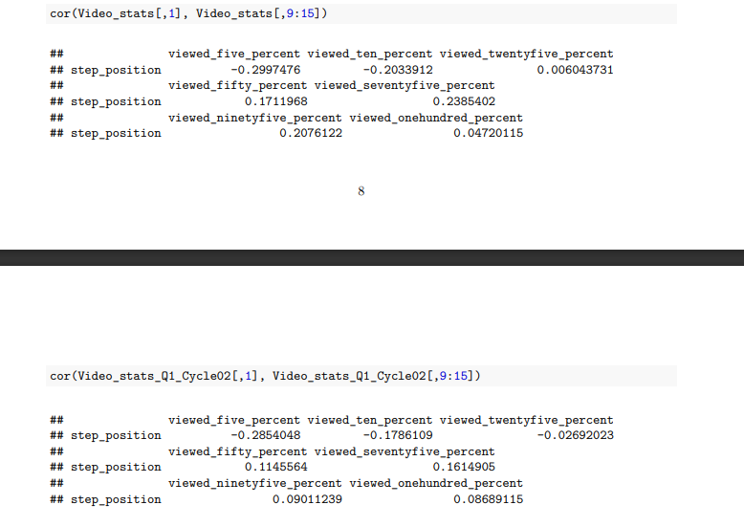
03. Conclusions from Correlation of Step-Position and Video-Viewed-Percentage-wise Datasets.
• As analyzed running the above specified code across the 3 loaded data files we can draw attention on the trend that with increase in step-position the video-viewed-percentage-wise of less percent data decreases for example according to data -with increase in step-position the 5% viewed data decreases, hence generally people who are interested in watching watches more and people who are less interested leave in the early step-positioned videos only.
• This assumption grows strong by seeing the correlation data trends of increase in step-position leads to increase in the video-viewed-percentage-wise of more percent data column. for example, according to data -with increase in step-position the 50%,75%,95%,100% viewed data generally found increasing, hence the assumption that generally people who are interested in watching watches more and people who are less interested leave in the early step-positioned videos only grows strong.
From business perspective: it can be stated that Company providing online sessions have a good content and keeping this type of content level will benefit the people who are deeply interested in learnings like Cyber-security and simultaneously the company will also grow.

Slide 6
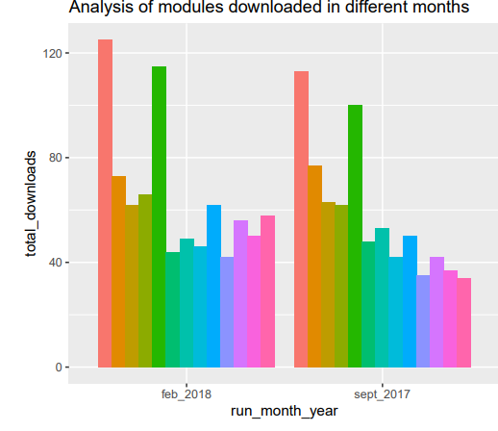
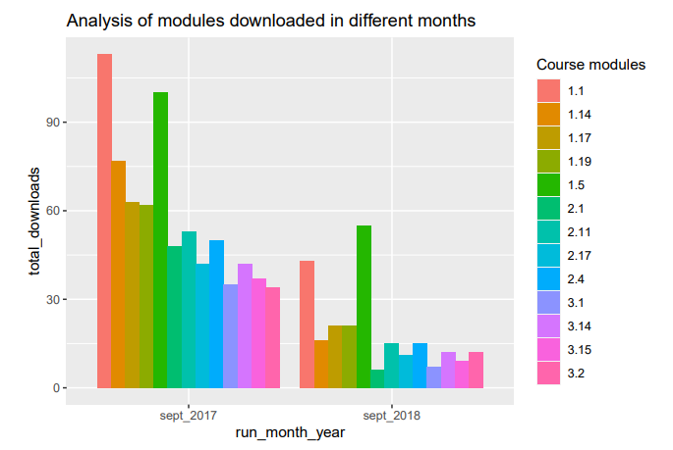
04 . Analysis of modules downloaded
This bar chart clearly shows that there is a relative increase in course downloads in feb, 2018 month compared to that of the sept, 2017 month.
This clearly represents that the learners are interested in the contents of the course and they downloaded the contents for further usage purposes.
This bar chart clearly shows that there is a decrement in course downloads in sept,2018 month compared to that of the sept,2017 month.
This clearly represents that the learners who wanted to perceive this course have already enrolled and completed the course before sept,2018 run or else learners are less interested in the contents of the course as compared to period of sept,2017
There was depletion in every topic-course that was being downloaded.

Slide 7
Conclusion
After a brief analysis and exploration of the data sets available, it can be said that the course modules are quite engaging for the learners considering the number of downloads of the course materials and other aspects.
The downloads depicts that the learners want to use it for reference later or share with other people.
The length of video however, at times makes the content lose it’s appeal on the viewers and they tend to not finish the course till the very end.
More information about the leaving responses of such learner or enrollement of the learners from time to time can be gained through the leaving response surveys and enrollment surveys conducted which is for now out of the scope of this particular analysis

